Slide 1

Data to Decision
Classroom Next-Gen CTO
Program 2023
Presentor : Tram Pham

Slide 2
Agenda
Meet & Greet – trao đổi về kết quả survey, mong muốn buổi học, agenda
Main topics
Data Platform and Data Management
Derive value from the enterprise’s data
Extra : Generative AI trend

Slide 3
5 NO
No deep-dive in any tools for today’s session
There is no single best solution that fits all needs
There is no future-proof architecture
There is not a good enough answer to “what-if” questions
There is no stand-alone technical solution. All technical solution has to serve a particular business goal and value

Slide 4
Survey Result
https://docs.google.com/forms/d/11gqdzpSMbqOaIJ0Zi2erb32YTlaKOlrv4-AZIMWTM7k/edit#responses

Slide 5

Focus of the session
Data Platform Solutions
Why should we build it?
How should we build it?
How should we manage it
- Data Insight
- How do we know to enrich current data?
- How do we gain insight into what we have?

Slide 6
Data Platform
Why should we build it?
How should we build it?
How should we manage it ?

Slide 7
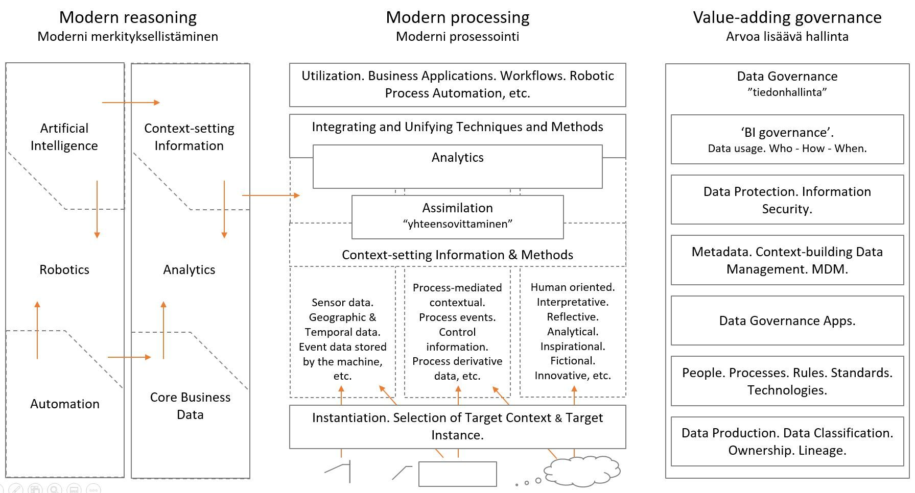
Modern data flow and governance

Slide 8

Why should we build it ?
Assess the scope, impact, and priority of known issues.
What is the use-case?
Evaluate current pain points and solution to address the root cause
Influence Stakeholders for MVP , PoC , PoV scope to evaluate the impacts

Slide 9
Why should we build it ?
Focus on business outcome
What are the desired business outcomes?
What are the current business challenges?
Who will use the platform?
What is the cost of doing nothing?
What defines the success criteria in terms of business outcomes?
Specific design KPI
How to tight the new platform to business outcome
Build small scope MVP of the platform
Demonstrate analytics use-cases

Slide 10
Why should we build it ?
Understand the current system architecture challenges:
What are the current technical challenges?
What type of analytics use cases are in the current system? Risk assessment, capture and analyze campaign feedback, customer churn?
How is your end-to-end process looks like?

Slide 11
Why should we build it ?
Options | Characteristics
On-premises data lakes | Difficult to deploy and manage, requiring large administrative teams and long deployment times.
Cloud data lakes | Reduced complexity but still required DevOps expertise and retain a sizable team
SaaS solutions | Fastest deployment, team members can focus on getting data insight than building infrastructure
There is no low-cost solution, one size fit all solution

Slide 12
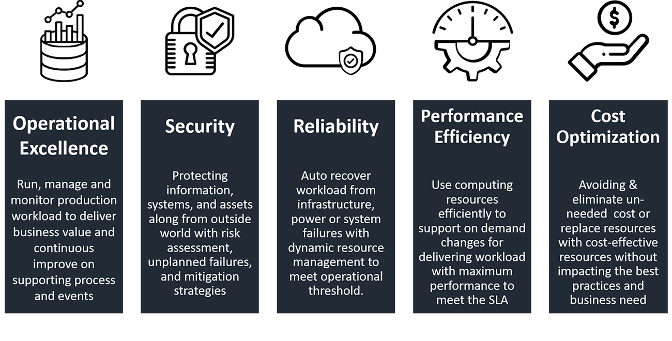
How should we build it?
Considering the area before designing a solution
- What are the design principles
What are the assumptions
What are the pain points and how does the architecture resolve the pain points?
What are the delivery approach ( lift and shift, modernization, hybrid) and timeline?
What is the estimate cost and ROI?
What is the Analytics Roadmap and Strategy?

Slide 13
SAMPE AREA OF CONSIDER - ETL WORKLOAD
Source | Target | Transformation | Workload
List of source | MVP scope to migrate/ modernize | Current tech stack | size and number of batch/ real time
Location | Target tables/ object | Success/ failure strategy of a workflow | Complexity workload breakdown
Source Sizing | Change in data model | Third party integrations | concurrent workflows
File format | Frequency of update/ insert in target platform | SLA agreement | List of jobs
metadata/manifest file | Data quality control | Jobs dependencies on the current tool ( eg scrips with functions only available in current tool | Type of migration
Scheduling | Table load strategy ( full/ scd1/scd2) | Job restart/ retry
Data Model | custom functions that need to migrate
ETL Cycle
Data refresh

Slide 14
Data movement through data lake layers
This architecture enables customers to vision a data lake platform in 1 year milestone
Sources
Ingestion
Raw
Pre-Processing
Staging
Post-Processing
Transformed
CoreCard
Customer Analytical Record
CoreBanking
CRS
Join Tables
Raw Data
Staging
Data
Ebank
Files
Batch ETL
(Full Refresh)
Apply Transformation
FTP
Segmentation Data
Batch ETL (Delta)
Apply Business Logic
1:1 copy of data sources
cleaned, pre-processed data in parquet data format
KMDB
quality checks
data cleaning
Data denormalization
MIS/MIS_2
Firebase
Personalize Data
API
Apps

Slide 15

Data Lake Storage Design (Number of layer and bucket depends on the business use case)
Data Lake Storage Layer
Landing Bucket : The place where encrypted data arrives from operational sources
Raw Data Bucket. Data is decrypted and PII Hash from the Landing bucket. Separate credential for PII Data will be managed under a different bucket with access restriction policy from any users.
Processed Data Bucket. Data that has passed basic validation and cleansing / correction.
Curated data (Consumption) bucket. Intended for loading into the data warehouse. Ready for visualization and consumed
User-Space data bucket. Space for Data Analyst, Data Scientist to develop their sophisticated data analytic modeling.

Slide 16
Data Lake Storage Design
Bucket | Landing | Processed | Curated
Tagging | Object Level | Object Level | Object Level
File Format | As is (source defined) | Parquet | Parquet
Compression Format | Can be applied when optimizing for cost-savings | Snappy | Snappy
Encryption (All Amazon S3 data is encrypted at Rest) | Server-Side encryption (AWS KMS) | Server-Side encryption (AWS KMS) | Server-Side encryption (AWS KMS)
Lifecycle | Will be driven by individual Object tags | Can have a bucket or Object level policy | Will be driven by individual Object tags
Is bucket Versioned | Yes | Not Required | Yes
Access | No User access. Only Service account will be used to move data in and out of the bucket | No User access. Only Service account will be used to move data in and out of the bucket | Users will have access to this bucket via a Lake formation – IAM
Bucket naming: <company>-<business use>-<purpose>-<environment>
The “purpose” can be: raw, processed, consumtion, logs, user-space, source-code
The “environment” can be: prod, dev, uat

Slide 17
DATA LAKE STORAGE TAGGING
Key | Value | Comment
Owner | Team | In different stages of the bucket and in user buckets having owner helps create data ownership
Security | Private/Public/Role | Helps in access control and data inventory
Environment | Dev/Prod/QA (UAT) | Having an environment tag helps use the same Amazon S3 bucket across environments and minimizes data duplication and helps end to end testing
Retention | Time frame | An object with a certain time frame can be moved into different types of Storage (S3 Intermittent Access, Glacier, delete etc.) for Cost-Savings Optimization.

Slide 18
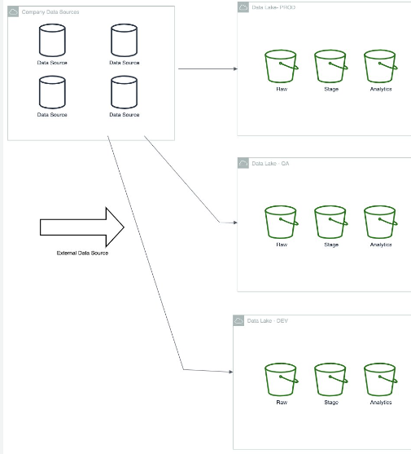
SAMPLE ARCHITECTURE STRATEGY
ACCOUNT,eg :
Separate account for development, Test (UAT - optional), and Production Account.
Data Storage will be mainly at the production account and copied through the development account with a limited data set time frame.
NETWORK
SEPARATE OF PROFILES (eg superuser, data engineers, data analysts

Slide 19
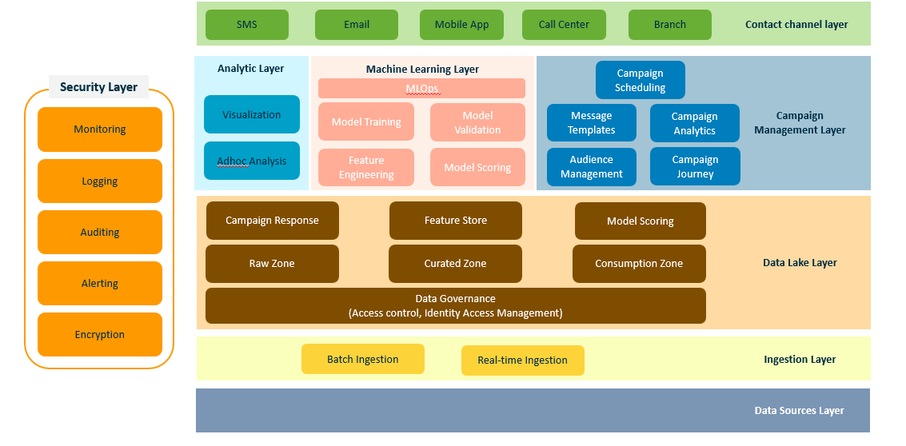
Data Lake ARCHITECTRURE SAMPLE

Slide 20
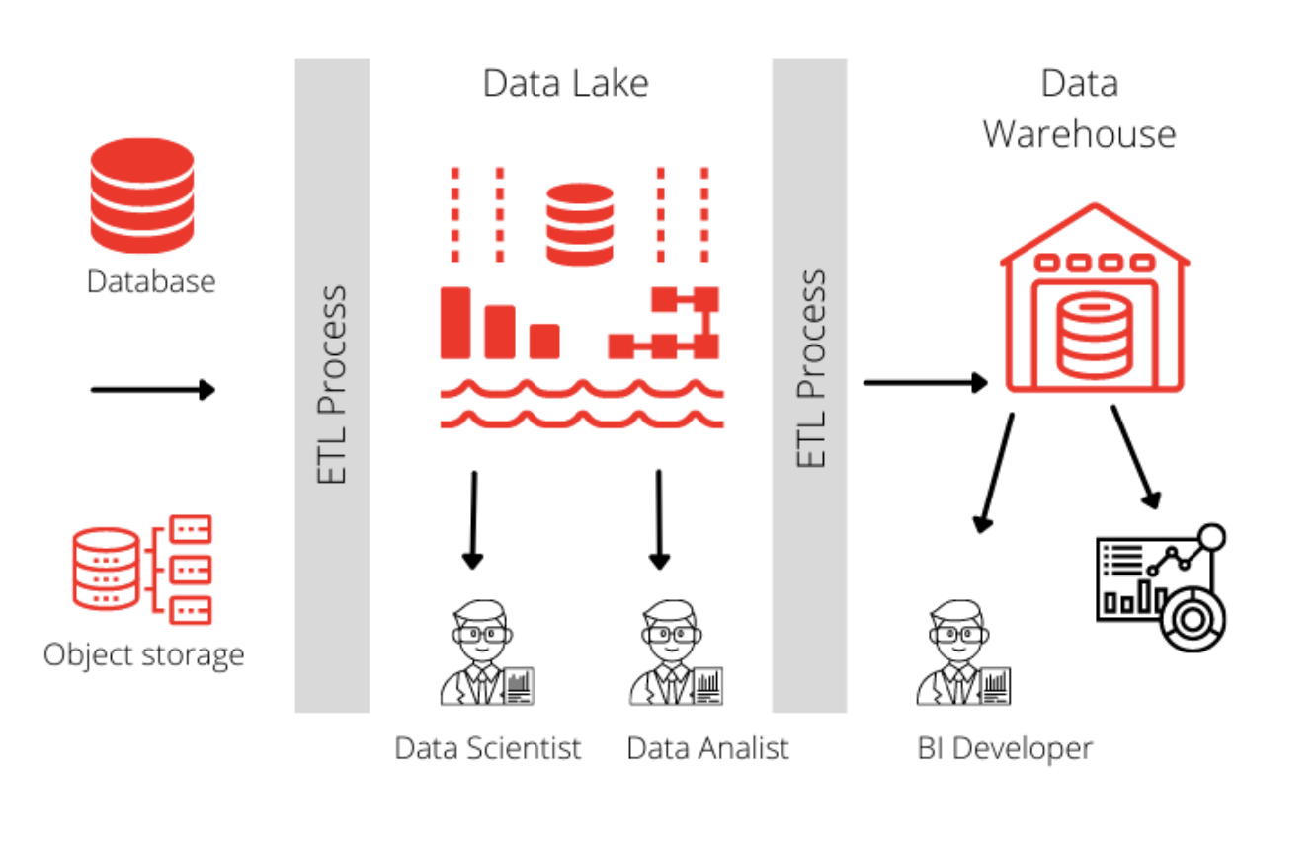
Lake house architecture

Slide 21
CHALLENGES OF DATA LAKE
Risk
To facilitate quicker data to insights within an enterprise, the below needs to be achieved
Business Units enabled to create and own data assets instead of relying on a central data team
Cross-team data sharing to improve visibility and democratize data assets in the enterprise
A standardized governance and security framework to facilitate data sharing between Business Units
Customer
Risk Data
Payment
Customer Data
Payment Data
Risk Processes
Customer Processes
Payment Processes
Data Platform
Data Store
Engineering Practices & Patterns
Marketing Data
Finance Data
HR Data
Notes:
Reduce turn around time to create data assets
Share the data that is created to other teams and Business Units
Follow security standards

Slide 22
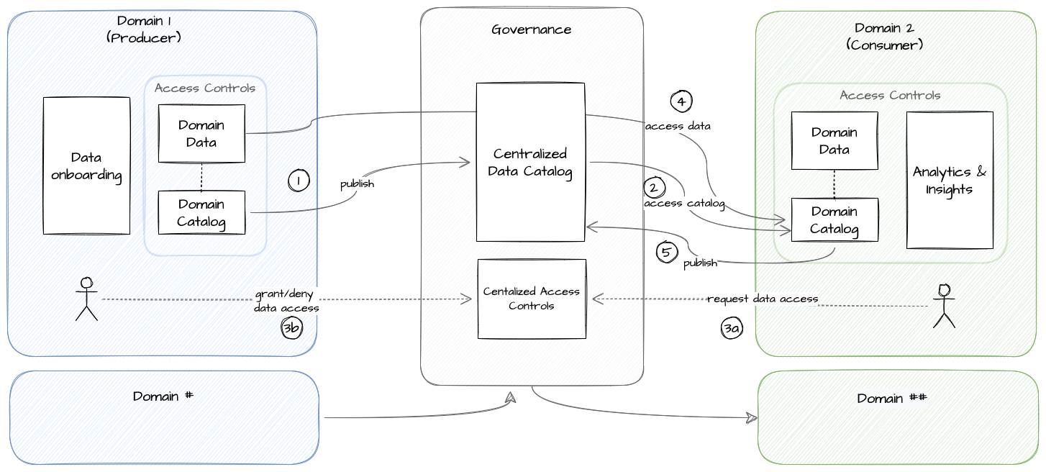
DATA MESH DATA FLOW
The producer onboards the data and persists the metadata in its local catalog a.k.a the Domain Catalog. It also publishes the metadata onto the Centralized Data Catalog.
consumer can access the Centralized Data Catalog and view the metadata (not the data) of the datasets published by producers.
A consumer can request access to datasets which is then approved or rejected by the Data Owner of the corresponding Data Domain.
Upon approval by the Data Owner, the consumer can start using the data assets over federated data reads for insights and analytics. The consumer manages data and insights Access Controls for the users within the domain.
Optionally, the Consumer may chose to publish data products back to the Centralized Data Catalog
Data Mesh is an adoption pattern for Data Platforms that de-centralizes creation and management of data assets, while centralizing the governance for sharing data products within an enterprise.
Notes:
1 - The producer onboards the data and persists the metadata in its local catalog a.k.a the Domain Catalog and manages Access Controls for the users within the domain. It also publishes the metadata onto the Centralized Data Catalog. 2 - A consumer can access the Centralized Data Catalog and view the metadata (not the data) of the datasets published by producers. 3 - A consumer can request access to datasets which is then approved or rejected by the Data Owner of the corresponding Data Domain. 4- Upon approval by the Data Owner, the consumer can start using the data assets over federated data reads for insights and analytics. The consumer manages data and insights Access Controls for the users within the domain. 5- Optionally, the Consumer may chose to publish data products back to the Centralized Data Catalog

Slide 23
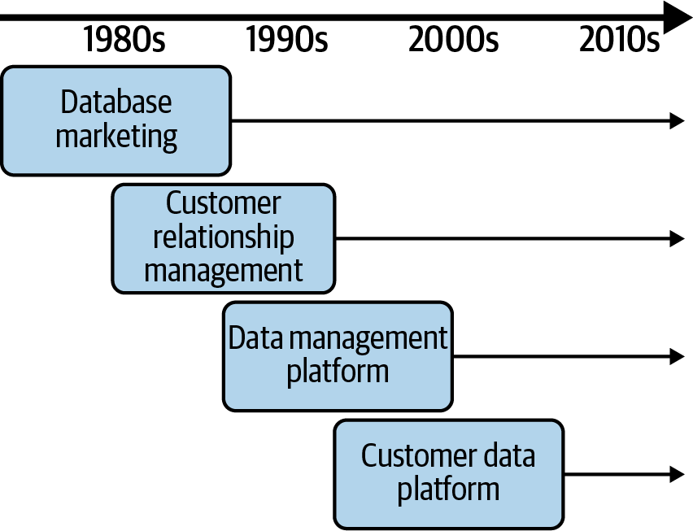
Customer Data Platform (CDP)
A customer data platform (CDP) is a data management system that consolidates and integrates data from multiple channels and sources to build a single, unified profile around each customer (CAR – customer analytics record). This data is then used to personalize marketing messages.
Progression of Marketing technologies

Slide 24
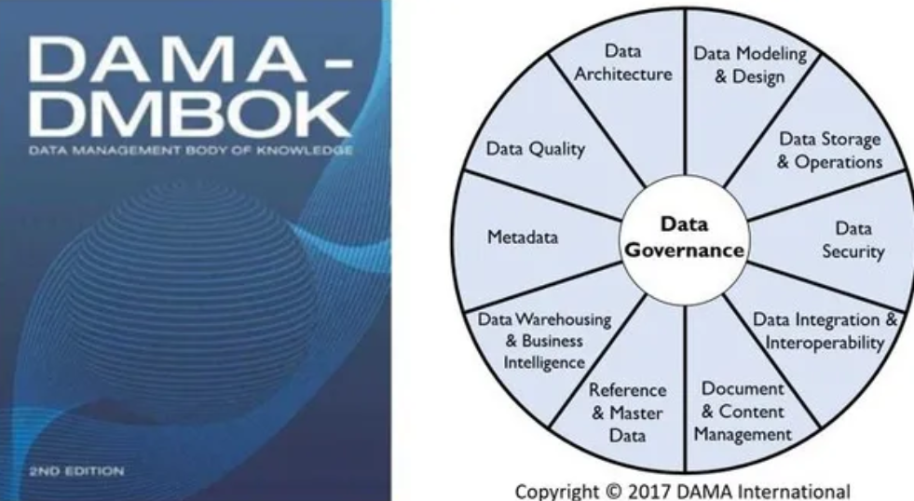
How should we manage data platform ?
“Data strategy is a plan of data management projects that support business goals. This strategy includes technology, along with improvements or changes to the organization, processes and policies.”
Gartner

Slide 25
COMMON MANAGE DATA WORKLOAD
Integrate governane
Data Catalog for managing data cycle, data discovery, and data access
Control table for the control plane to orchestrate data pipelines
PII Data handling

Slide 26
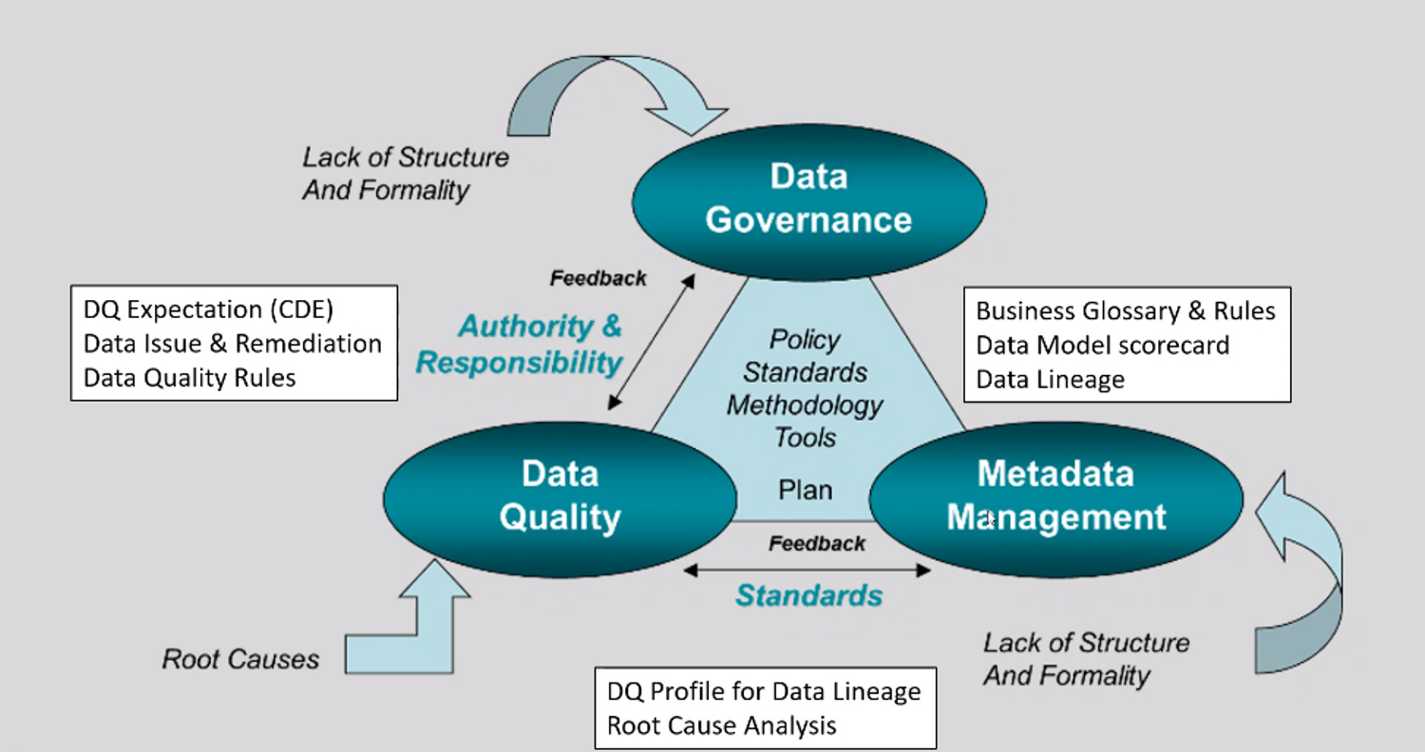
Relation of DQ, DG and Meta Management

Slide 27
Data Management
Deliverables :
- DQ Framework
- DQ program
- Analyses from Data Profiling
- Recommendation
- DQM procedures
- DQ reports
- DQ SLA
- DQ Policies and guidelines
- DQ Expectation
In red : Data Manager
Understand and prioritize business needs
Define a data quality strategy
Identify data critical to business needs
Define business rules and data quality standards
Assess data against expectations
Share findings and get feedback from stakeholders
Prioritize and manage issues
Identify and prioritize opportunities for improvement
Measure, monitor and report on data quality
Manage Metadata produced through quality processes
Integrate data quality controls into business and technical processes

Slide 28
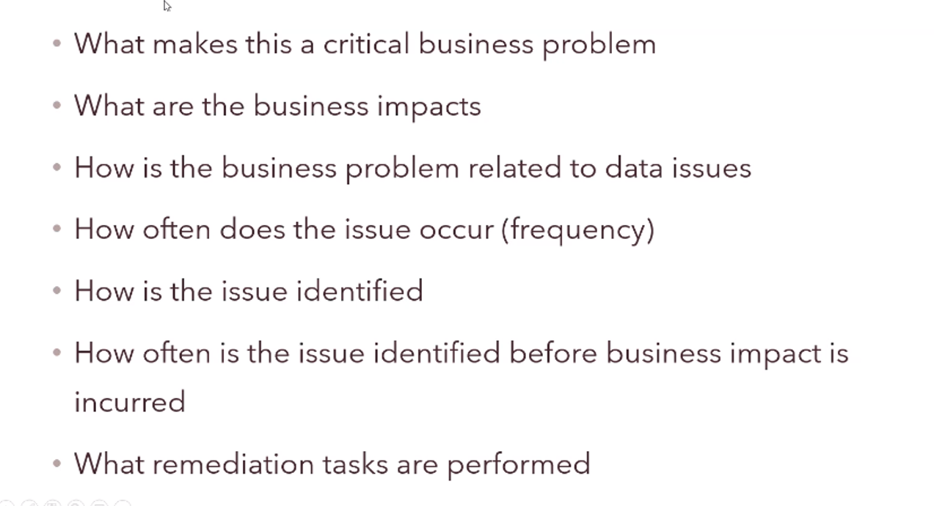
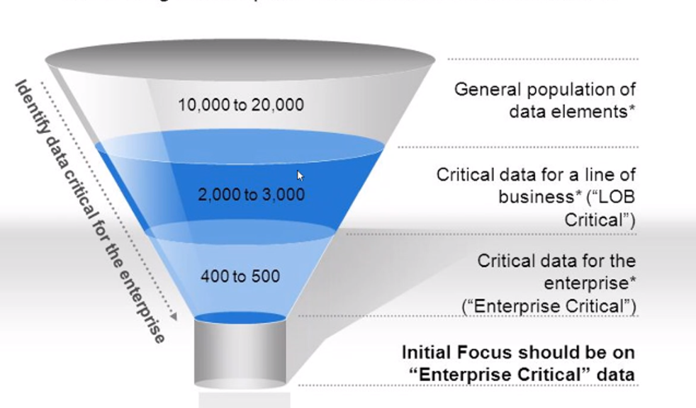
Identify Data Issues - Interview

Slide 29
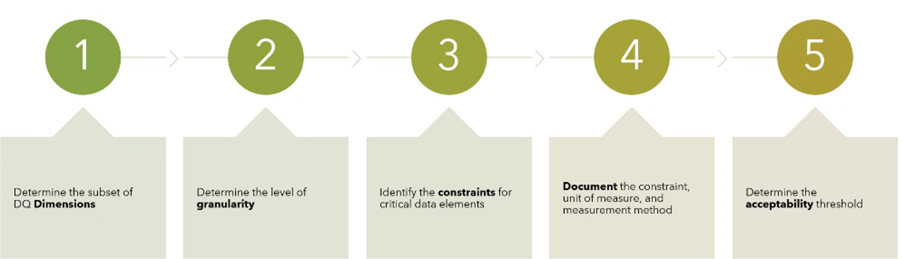
DQ Expectation Playbook

Slide 30
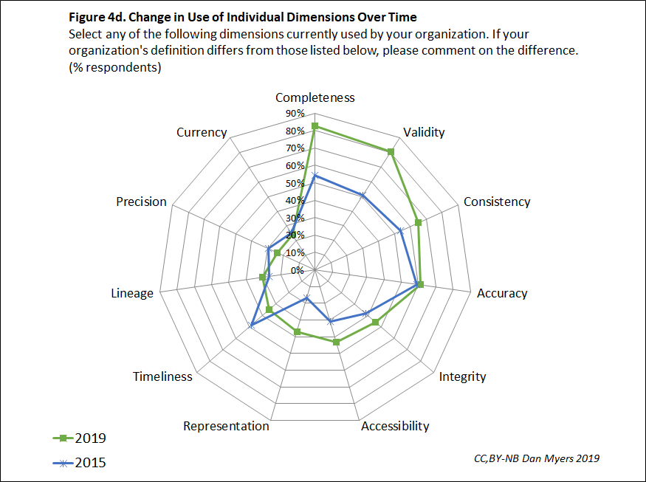
Data Quality Dimension Usage Trends

Slide 31
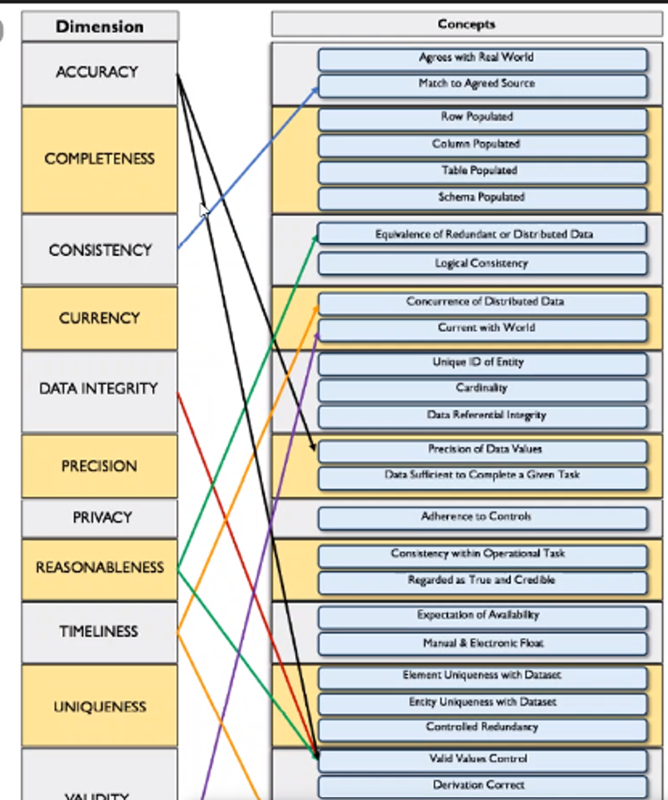
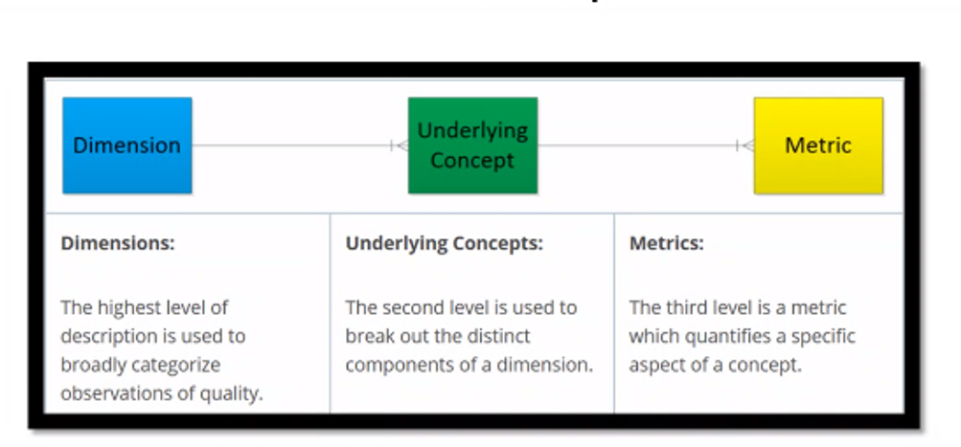
Dimension to Concept

Slide 32
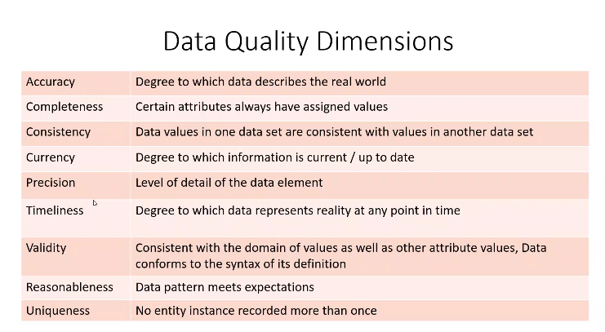
Sample Data Quality Dimensions

Slide 33
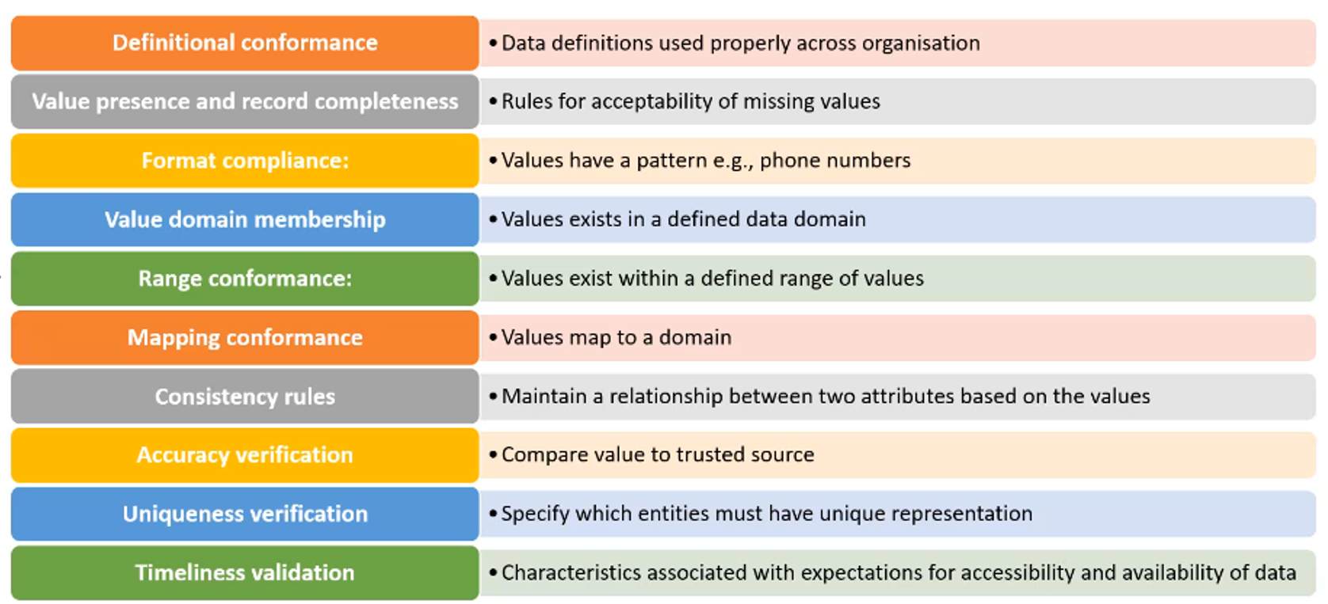
Data Quality Business Rules

Slide 34
Sample Data Quality Rules

Slide 35
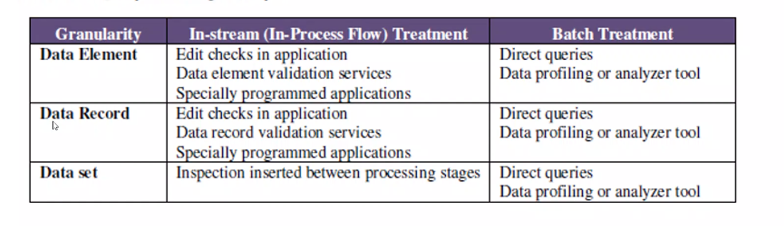
Data Quality Monitoring Granularity
Common workload to monitor data quality
Data profiling – statistics of columns ( rows count, columns count, data type)
Schema validation – reject dataset if conditions not met(eg contain additional columns. Different data type)
Schema Evolution
Unit test

Slide 36
Data profiling
Layer : Raw & Serving Layer
Target Audience : Data Governance(DG), Data Engineer(DE) , Data users (DU)
Reason :
Data Profiling in raw layer helps DE keeps track of the data from source to raw layer
Data Profiling in serving layer helps DU keep track of the deviation and variance within the data from one day to the others

Slide 37
Schema validation
One of the common Big Data tools is Spark has inferSchema which will take a sample of your dataset and infer the schema type
Schema validation ensures your schema is consistent throughout layers you should define your schema on curated and serving layers
If a table fails the schema validation it will alert Data Engineers to rework the job. In this way you don’t have to worry about undetected changes
Layer : Process/ Curate layers​
Target Audience : Data Governance(DG), Data Engineer(DE), Analytics Engineer​
Reason : ​
Schema validation ensures that potentially breaking changes are found earlier in development cycles, and can also help prevent unintentional schema changes due to human error​

Slide 38
Unit Test
This is depending on your ETL and DU / BU requirements
The usecase of this is after ETL you would want to check whether you have to crawl the correct data by building test cases around that dataset
It could be test to see duplicate rows, columns , contains certain field, No null, No Negative, Uniqueness, e.g
There is multiple tools that you can use such as Deequ ( AWS)

Slide 39
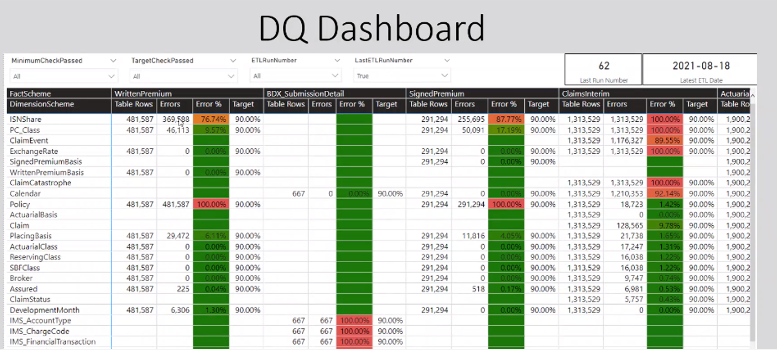
Sample DQ Dashboard

Slide 40
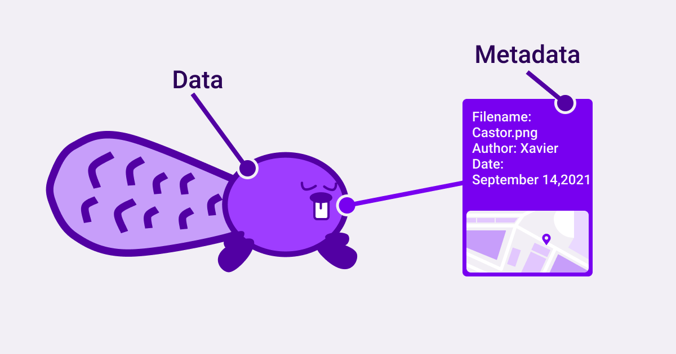
MANAGE DATA WITH METADATA TABLES
Meta-data is the type of data that describes the information of your dataset
Importance of metadata :
Help users to accessed and understood in the context in which they were created and used
Ensure the data authenticity is intact over time
Metadata acts as a reliable evidence layer for data security and auditing

Slide 41
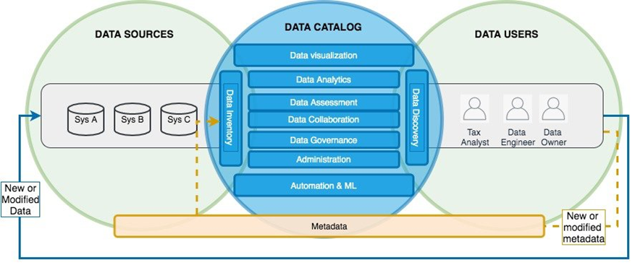
META DATA ROLE ON DATA LAKE
In a data lake environment, metadata acts as a catalog layer to help users:
Find the right data context by describing data characteristics and classification
Help ensure data consistency and completeness
Navigate to the data location
Manage data life-cycle through data lineage
Ensure data security through data sensitivity and access level

Slide 42
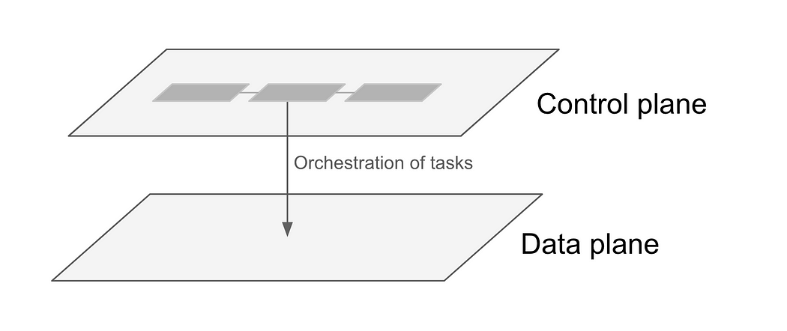
METADATA USECASE ON DATA LAKE
Data Catalog for discover technical and business data
Use as attributes to build control table for Control Plane / Framework in ETL Pipelines

Slide 43

Sample Fields
after pipeline success, contains the below parameters
Invoke_scraper EVENT_Name: Name of the scraper previous state machine which will trigger the Pipeline
Job_Name: job name needs to be triggered as part of the Pipeline
event_Name: Corresponding scraper name once the Glue Job is over
pipeline group
Group name: Name of the group pipeline belongs to
Job_Name: Glue job name needs to be triggered as part of the Pipeline
job logging
Jobname_Date :- ETL Job Name and Run Date (for Unique Value)
Job_Name :- ETL Job Name
Start_Date :- ETL Job Start Date
Start_Time: ETL Job Start Time
End_Date: ETL Job End Date
End_Time: ETL Jod End time
Job_Status :- SUCCEEDED/FAILED/CANCELLED
ExecutionTime: Billed Time is Sec for Glue
CONTROL FRAMEWORK
ETL CheckPoint
Table Configuration
ETL Execution Control Table
OLAP CheckPoint
ETL Inventory
Data Lake Control Framework is a set of control tables which store:
Information/ logs to each tables being processed, including how many rows have been processed and at what time, by which Data Lake Stage.
Act as guideline for Data Processing Jobs to manage resources should be run and what logic is being used for a particular transformation job, in table-columns level.
Sample Table | Sample Description
ABZ_sdlf_prd_etl_check_point | Save last run date time of the SDLF Process, control and identify next new batch run
ABZ_sdlf_prd_etl_execution | Capture all ETL Information at stages: Landing, Raw, Processed, Consumption. This table also in charge of each ETL Run Status
ABZ_sdlf_prd_etl_inventory | Store Consumption Zone ETL jobs for Reports with their specific input parameters (dependencies, number of workers per Job…)
ABZ_sdlf_prd_olap_table_checkpoint | Store and control information on OLAP table, what’s the last snapshot? What’s the last delta part? Last update of each table
ABZ_sdlf_prd_table_configuration | Store and control information on all ingested tables, using for both on premise and aws environment

Slide 44
Sample etl control tables
Table 1 – prior pipeline stating , contains the below parameters
FileName : Source File Name
Job_Name: ETL job name needs to be triggered once file is arrived
scraper_Name: Corresponding scraper name once the ETL Job is over
Job_enable: Y/N – whether to enable the pipeline or not
Table 2 – after pipeline success, contains the below parameters
Invoke_scraper EVENT_Name: Name of the scraper previous state machine which will trigger the Pipeline
Job_Name: job name needs to be triggered as part of the Pipeline
event_Name: Corresponding scraper name once the Glue Job is over
Table 3 – pipeline group
Group name: Name of the group pipeline belongs to
Job_Name: Glue job name needs to be triggered as part of the Pipeline
Table 5 – job logging
Jobname_Date :- ETL Job Name and Run Date (for Unique Value)
Job_Name :- ETL Job Name
Start_Date :- ETL Job Start Date
Start_Time: ETL Job Start Time
End_Date: ETL Job End Date
End_Time: ETL Jod End time
Job_Status :- SUCCEEDED/FAILED/CANCELLED
ExecutionTime: Billed Time is Sec for Glue

Slide 45
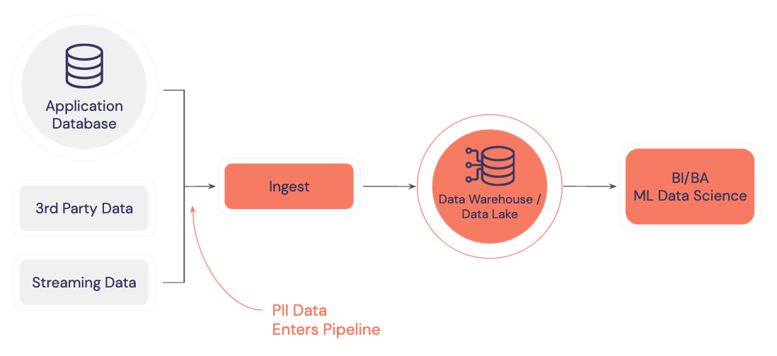
HANDLING PII DATA

Slide 46
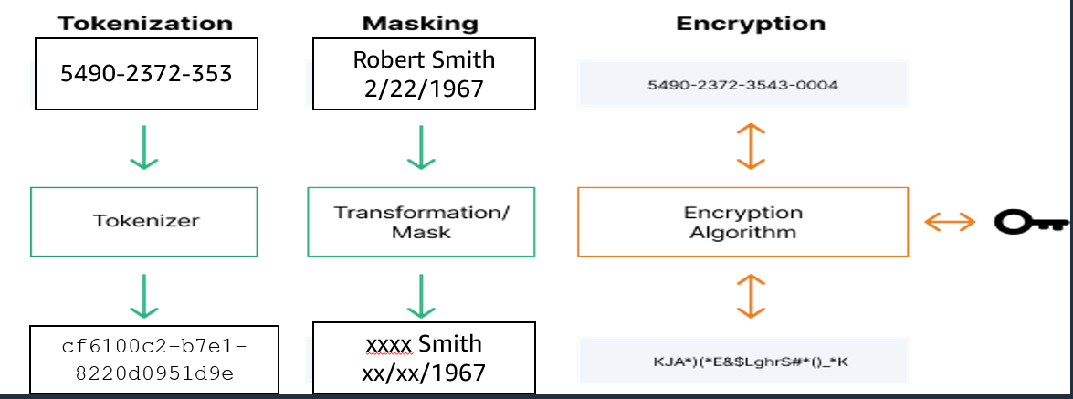
Obfuscation / Anonymizing
It is a process that sensitive pit of data are transformed into something that never be linked back to the original content
3 data obfuscation methods

Slide 47
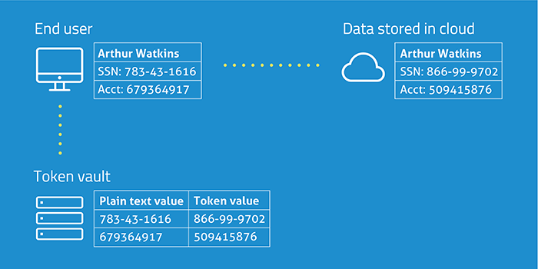
Tokenization
Tokenization is the process of substituting sensitive information with a token that can be later used to retrieve the actual data
It requires a significant processing overhead to tokenize and detokenize
The tokenizer system will require administration and careful maintenance
Common use-cases :
Avoid sharing PII data with the service providers when sharing certain data set through tokenized elements such as phone numbers, credit card number
47

Slide 48
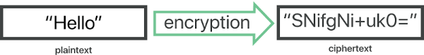
Encryption
Encryption works by using an algorithm with a key to convert data into unreadable data (ciphertext)
The data can only become readable again with the right key
There are several different types of encryption algorithms, all using different types of keys
Protecting and managing the keys becomes a critical part of any encryption solution
Common use-cases : Encrypt data in transit / at rest to ensure the sensitive business information is not human-readable
48

Slide 49
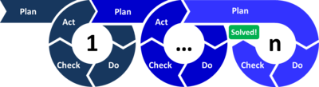
The Shewhart/Deming Cycle problem-solving model
Plan:
Assess the scope, impact, and priority of known issues.
Evaluate alternatives to address at the root cause.
Do:
Address issues at the root cause.
Plan for ongoing monitoring of data.
Act:
Address emerging data issues.
Check:
Actively monitor data against standards.
If data falls below standards, act to bring it to acceptable levels.

Slide 50
DATA INSIGHT
- How do we enrich our data ?
- How do we gain insight into what we have?

Slide 51
How do we enrich our data ?

Slide 52
New Data Source Collection Solutions Sample
Industry | Company type | Challenge | Solution | Benefits
Manufacturing & Automotive (MFG) | Home Energy Providers | Collect consumption data in real time. | Develop new type of meter integrated with home internet connect. | Capture real-time data to perform analytic and generate alerts to encourage energy saving.
Digital Logistics (DLG) | FMCG Products Through Resellers | Can’t access end-user’s behavior due to B2B2C model to determine new product lines. | Reward or Loyalty Program, social network connection, cookies stitching, data from partners. | Understand user’s behavior, engagement, feedback to enhance or develop products.
 | Consumer Electric Home Appliances | Can’t access end-user’s demographic data due to B2B2C model. | Implement digital warranty, DIY by end-users. | Able to collect end-user bio with purchased products.
 | Weather and Transportation | Lack of real time update data and become invalid when get updated. | Crowdsource data by lead users to live update others. | Traffic status is short time validation therefore data value to end-user can be added.
Financial Services Group (FSG) | Bank and insurance | User engagement in using daily its application | Using Analytic Tags to find hot spots (most touch) and confused spots. | Remotely understand user experience to continuously improve and optimize

Slide 53









X-Data and O-Data for Customer 360 View
X-Data
O-Data
Stores
Omni-Channel
Operation
Processes
Customer Experience
Behavior Data
NPS response
Standardization
Sustainability
Flexibility
E-Commerce
Predictive Analytics
Salesman
Customer Data
Demand Driven Analytics
Targeting and Marketing
Servicing
Automation
Personalization
Segmentation
Loyalty
Unified Experience
Customer Feedback
Self-Service
Online channels
Big Data
End-to-end processes
Extensibility Integration
Open Ecosystem
Business Intelligence
Services

Slide 54
Customer Data Platform (CDP)
A customer data platform (CDP) is a data management system that consolidates and integrates data from multiple channels and sources to build a single, unified profile around each customer (CAR – customer analytics record). This data is then used to personalize marketing messages.
Progression of Marketing technologies

Slide 55
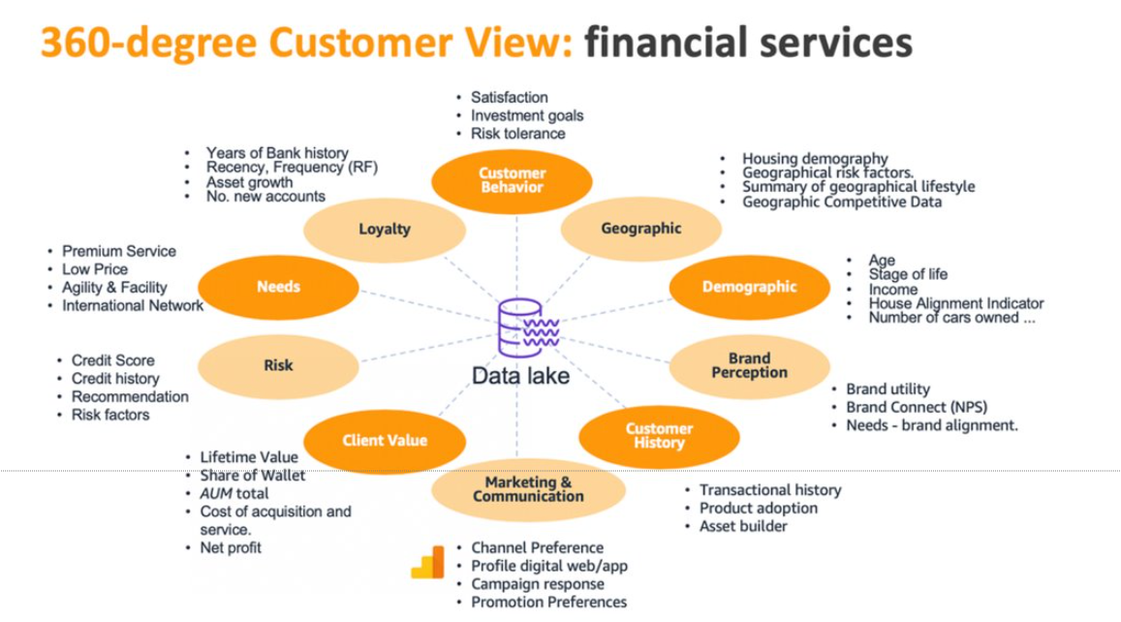
A 360 DEGREE CUSTOMER VIEW
traditional master data set of “row and columns )
“Relationships” tend to be one dimensional e.g. parent and child, bill and line items, list of services for a customer.​
A more modern approach is a graph database to create a 360 view of the customer

Slide 56
MOTIVATION FOR CDP
Increase Volume , Value , Velocity of data
Omni channel engagement and attribution
Personalization of Experience and Products
Customer Data needs to be connected from multiple sources instead of being in isolated silos

Slide 57
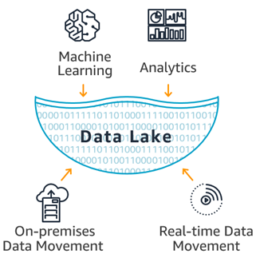
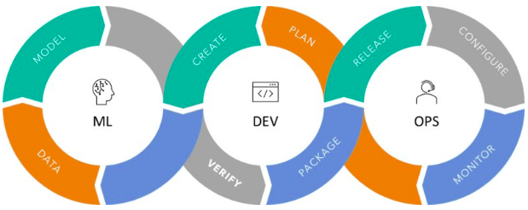
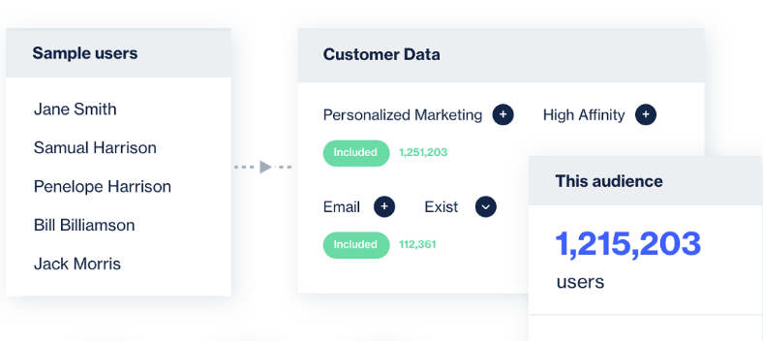
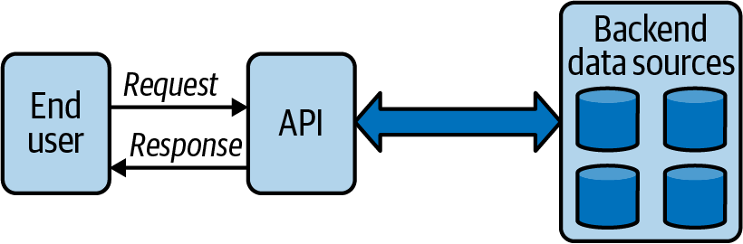
Key features of CDP
Data Lake : The Data Lake serves as the foundation, which is then integrated into the CDP
Ops : Automation of workflow , model deployments , management using x-Ops practices ( MLOps/ ModelOps / DataOps)
API : standardize and facilitate this sending and receiving of data across platforms and devices
Interface: User-friendly interface

Slide 58
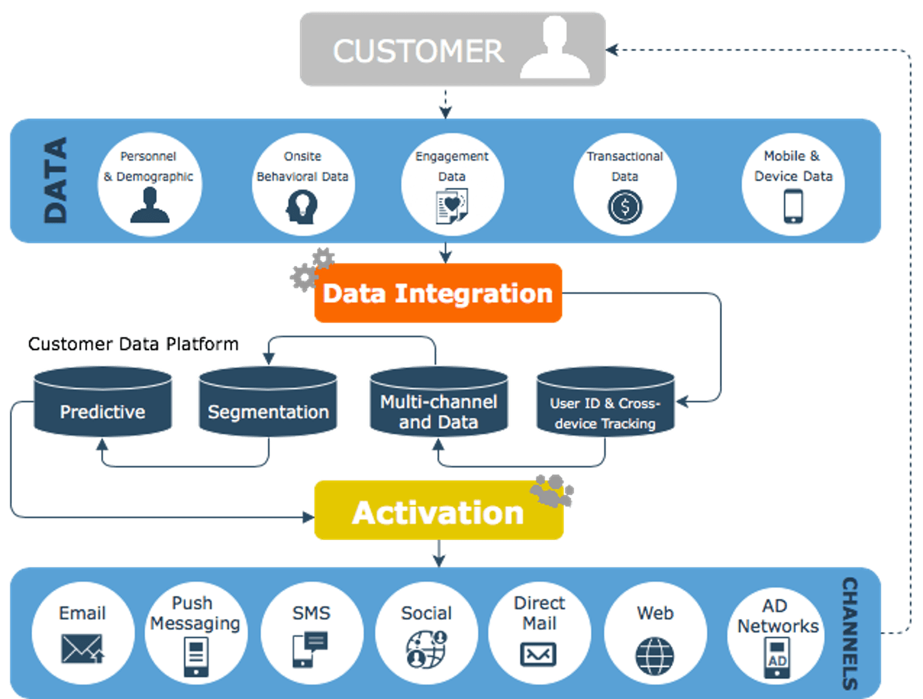
Conceptual design of CDP

Slide 59
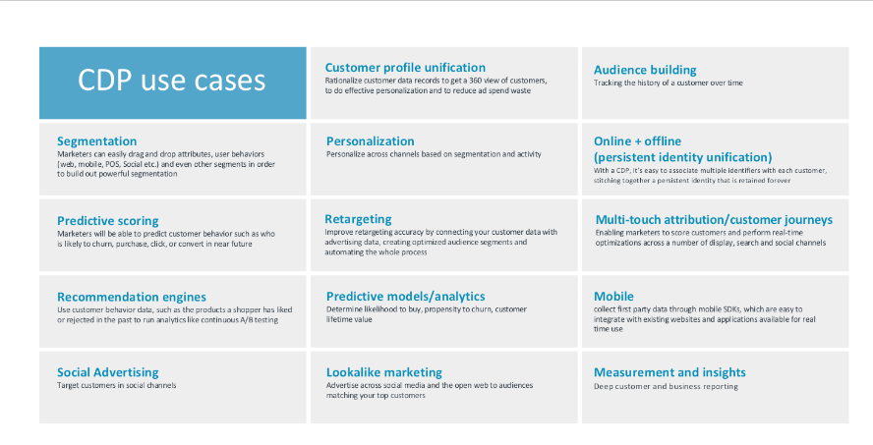
COMMON CDP USECASES

Slide 60
- How do we gain insight into what we have?

Slide 61
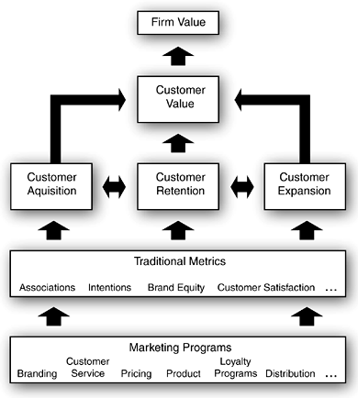
TRADITIONAL METRICS VS CUSTOMER DRIVEN METRICS
Traditional Metrics
Sales, Product profitability
Market shares, Satisfaction
Customer –analytics driven metrics
Customer profitability
Customer acquisition (rate, cost)
Customer margin (dollar, growth)
Customer retention (rate, cost)

Slide 62
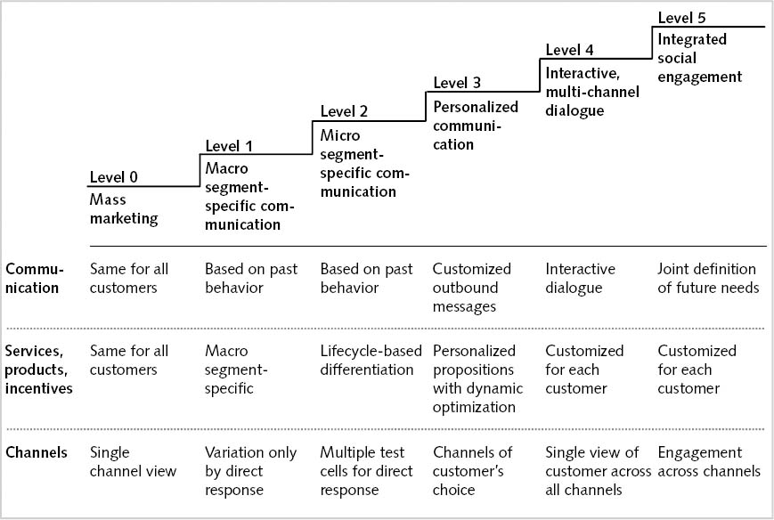
PERSONALIZE COMMUNICATION CHANNEL WITH CUSTOMER FOCUS METRICS
Look at the CDP architecture. How does CDP help businesses achieve the communication level?

Slide 63
BUILD A CUSTOMER SEGMENTATION MODEL
SEGMENTATION
PERSONALIZE
ETL and clean the dataset
Build a dataset with relevant features such as
Churn
RFM – recency , frequency, momentary
Ownership ( # of products. Tenure)
Transaction and usage
Lifestyle
Run segmentation algorithm such as K mean
Analyze output cluster characterize
Create a list of all current promotions and rewards
shortlist segments to target for campaign execution
Map segments
Develop “personalization strategy”

Slide 64
NOT ALL SOLUTIONS NEED TO BE DATA SCIENCE- CUSTOMER JOURNEY
Have a hypothesis of how the customer is experiencing your product
Start from the first interaction with the company
Build a short journey for effective measuring. You can break it down to stream, eg:
Stream of customers apply for a banking product
Who got declined?
Who didn’t provide information?
Who dropped off the documents?
Stream of how people use services on their accounts
Make sure to zoom in at specific angles, such as growth deposit

Slide 65
NOT ALL SOLUTIONS NEED TO BE DATA SCIENCE- BUILDING DASHBOARD
Overview dashboard helps data analyst/scientist discover new features for the dataset
All dashboard needs to be for a specific audience, with drill-in features per requested and defined metrics that lead to actionable decisions. A sample of the questionnaire as below
What line of business is this KPI relevant to? | Who is going to use the dashboard | Why do we need this KPI / Metric / | What is your existing benchmark for success? | What does success business outcome looks like for you | What data would help you achieve the outcome
Sales | Sales Executive |  |  |  | Customer, Sales Transaction

Slide 66
Data Analytics Continuum - data is turning it into business value
Descriptive Analytics
Diagnostic Analytics
Prescriptive Analytics
What happened?
Why did it happened?
What will happen?
How can we make it happen?
Operational Analytics
What is happening
Data - Information – Knowledge – Insight - Wisdom
Value
Statistical analyses
Prediction modeling
Hypothesis testing
Risk scoring
Simulations
Business optimization
Personalized experience
Decision support
Behavioral analysis
Alerts
Business activity monitoring
Security events monitoring
Privacy analytics
Extracts
Reports
Dashboards & Scorecards
Benchmarking
Auditing and monitoring
Diagnostics
Variances
Correlations
Data Mining
Classifications
Challenge

